Slide 1


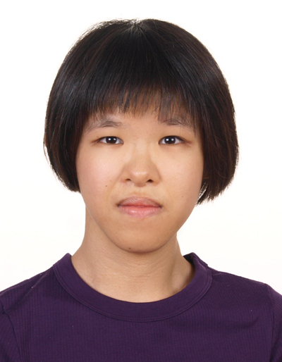

TOMOWORK GOAL SETTING WORKSHEET
NAME
Chong Kay Lin
INSTITUTE
Republic Polytechnic
GOAL START DATE
20 MARCH 2023
GOAL COMPLETION DATE
1 JUNE 2023
MY CAREER GOAL IN 1 YEAR
WORK
Secure employment in the healthcare industry (associate dietitian) if I cannot get into local university
LEARNING
Enter SIT (Dietetics and Nutrition) / SUSS or NUS (Social work)
ACTIVITIES
Volunteer in Healthcare-related programmes e.g. TriGen by SGH
5 THINGS I WANT TO ACHIEVE FROM TAP (Please include more than 1 soft skills)
ACTION THAT WILL HELP ME TO REACH MY GOAL
REVIEW
(REVIEW BY 31 MAY MORNING)
1 | Gain confidence in my corporate project.
2 | Improve CV.
3 | Improve communication skills.
4 | Learn skills transferable to the HC industry.
5 | Contribute meaningfully to corporate project.
1 | Be confident and maximise my strengths, apply them in the corporate project.
2 | Apply tips shared in CV enhancement sessions to improve my CV.
3 | Apply PEEL structure to phrase my sentence.
4 | Identify skills that are transferable to healthcare industry e.g. Design thinking
5 | Identify my strengths that are useful to contribute to the corporate project.
1
2
3
4
5
COMMENTS FROM FACILITATORS

